Slide 1
Information for Department Heads and DGPs September 2021
A Change Model for
Doctoral to Faculty Diversity in STEM
This material is based upon work supported by the National Science Foundation under Grant Nos. 1820536 182058 and 1820582. Any opinions, findings, and conclusions or recommendations expressed in this material are those of the author(s) and do not necessarily reflect the views of the National Science Foundation.

Slide 2
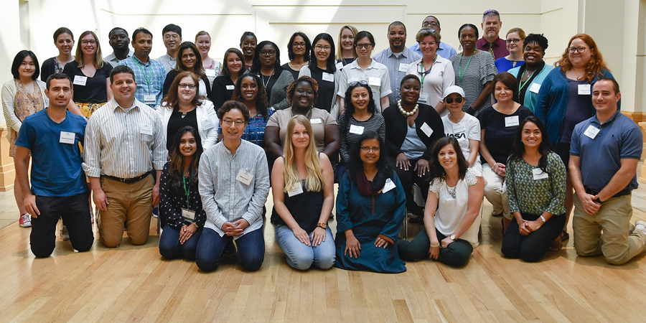
Agenda
Welcome and Introductions
Overview of the AGEP-NC project
Aims
Approach and model of change
Roles of Fellows, Department Heads, DGPs
Surveys and interviews

Slide 3
Welcome and Introductions Leadership Team AGEP-NC Fellows Department Heads and DGPs

Slide 4
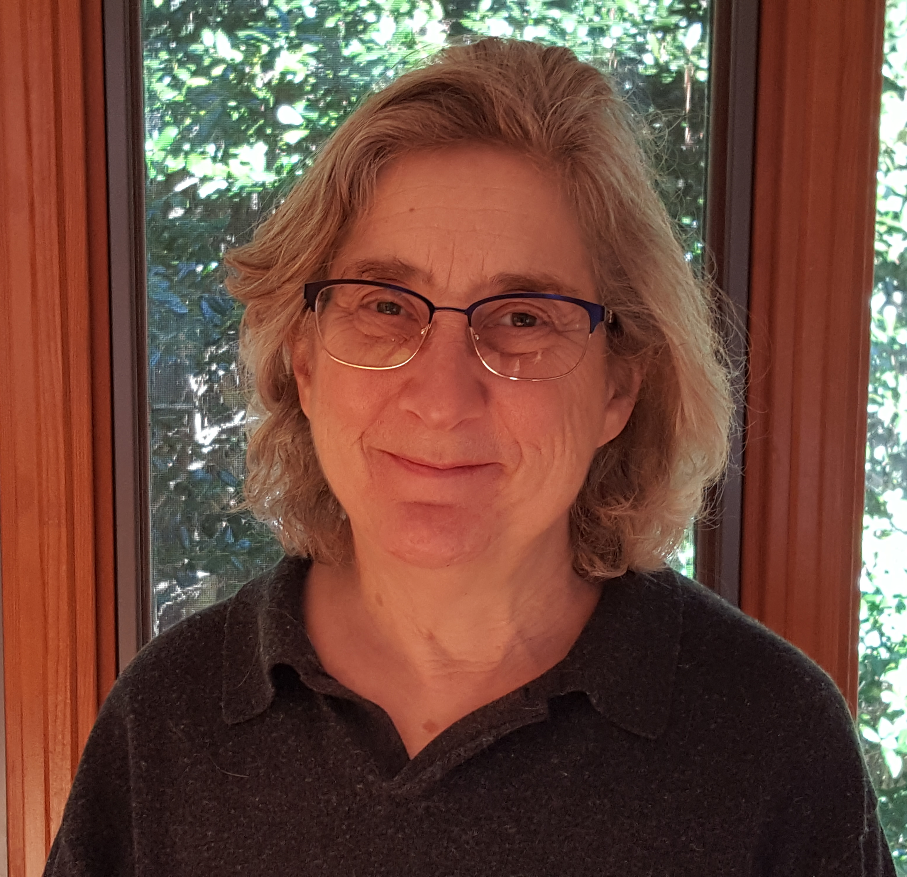
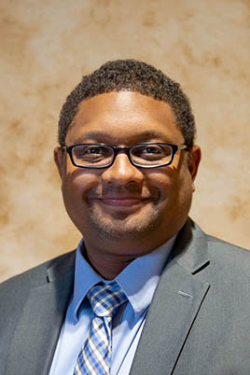
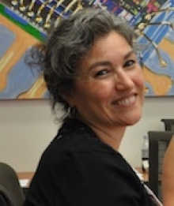
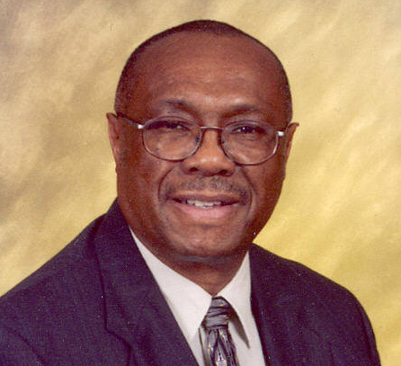
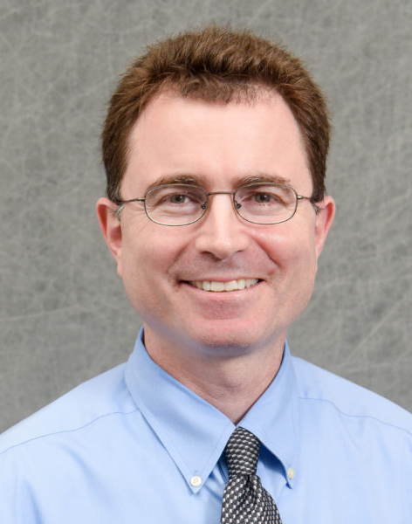
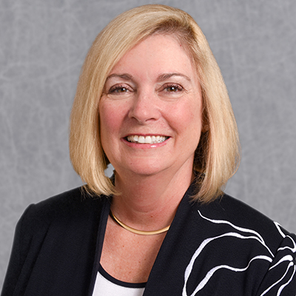
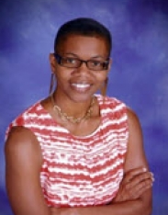
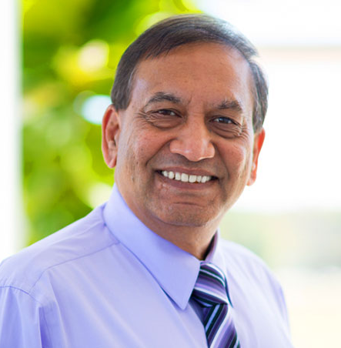
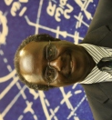
Leadership team

Slide 5
NC State Participating Departments
Cohort I AGEP-NC Departments
Applied Ecology, Biochemistry, Chemistry, Poultry Science, Statistics
Cohort II AGEP-NC Fellows
Biological and Agricultural Engineering, College of Natural Resources
Forest Biomaterials, Forestry and Environmental Resources
Marine, Earth and Atmospheric Sciences, Mathematics
Parks, Recreation and Tourism Management
Cohort III AGEP-NC Fellows
Biomedical Engineering, College of Engineering, Computer Science
Mechanical and Aerospace Engineering
Textile Engineering, Chemistry and Science
Promote diversity in the doctoral programs within the disciplines.
Cross-cultural Mentoring
Diversity Discussions and Initiatives
Study pathways through doctoral program
Develop departmentplan

Slide 6
AGEP-NC Aims
Develop, implement, and study a model for creating institutional, department-level and faculty change Promote PhD completion and progression to faculty careers among historically underrepresented minority US students in STEM disciplines.
Website: agep-nc.org

Slide 7
Approach: Focus on Faculty and Departmental Planning
Why?
Faculty set program requirements and culture
Dissertation advisors have direct impact on progress and career direction
How?
Faculty Fellows monthly reading/discussion group
Departmental discussions and programming regarding mentoring and diversity and inclusion in the discipline
Faculty study URM student experiences and progress through doctoral program
Sensemaking initiatives within the department and discipline
Faculty develop departmental plan to promote success of URM doctoral students

Slide 8
Model of Change
Widespread synergistic participation across campus is key to success.
Action by faculty change agents and support and promotion from department heads and deans have both been found necessary to effect change.

Slide 9
Model of Change
(Kezar and Eckel)
Supportive
Leaders
Shared
Leadership
University and College Level
Provosts
Deans
Graduate Schools
Faculty Development
Other Administrators
Sensemaking
Share Data
Approaches
Skills
Visible
Actions
Department Level
AGEP-NC Fellows
Department chairs
Graduate directors
Department faculty
Robust Design
(flexible)
Input into Vision
Students
Climate surveys
Project participants
Research on mentoring
External Advisory Board
Continuous process evaluation
Develop-
ment
for all

Slide 10
Roles of AGEP-NC Fellows
Participate in monthly meetings during the academic year. Readings and discussions about culturally responsive mentoring, experiences of URM doctoral students, institutional change
Participate in project surveys and interviews about mentoring and department culture

Slide 11
Roles of AGEP-NC Fellows
Lead the following efforts, with help from AGEP-NC leadership team and the department head and DGP
Compile information about the pathways and progress of URM students through the doctoral program to try to identify barriers and elements that promote the success of URM students.
Share data and survey results with the faculty and graduate students
Design and implement a small initiative to acquaint faculty with some aspect of inclusive doctoral programs. (Grant provides up to $2000 per year per Fellow)
Coordinate the faculty in developing a departmental plan for promoting the success of URM doctoral students.

Slide 12
Roles of Deans, Department Heads and DGPs
Provide data about demographics, degree completion and career progression of URM doctoral students.
Participate and promote surveys about department climate and mentoring.
Promote AGEP-NC project activities and goals within your department/college
Provide the Fellow release from other service obligations.
Attend annual Alliance-wide meeting for the two years of the Fellow's term. We will also ask you to come to some additional informational meetings if you can.

Slide 13
Roles of Deans, Department Heads and DGPs
Help the Fellow
Share data and survey results with the faculty and graduate students
Implement an initiative to acquaint faculty with some aspect of inclusive doctoral programs.
Coordinate the faculty in developing a departmental plan for promoting the success of URM doctoral students.

Slide 14
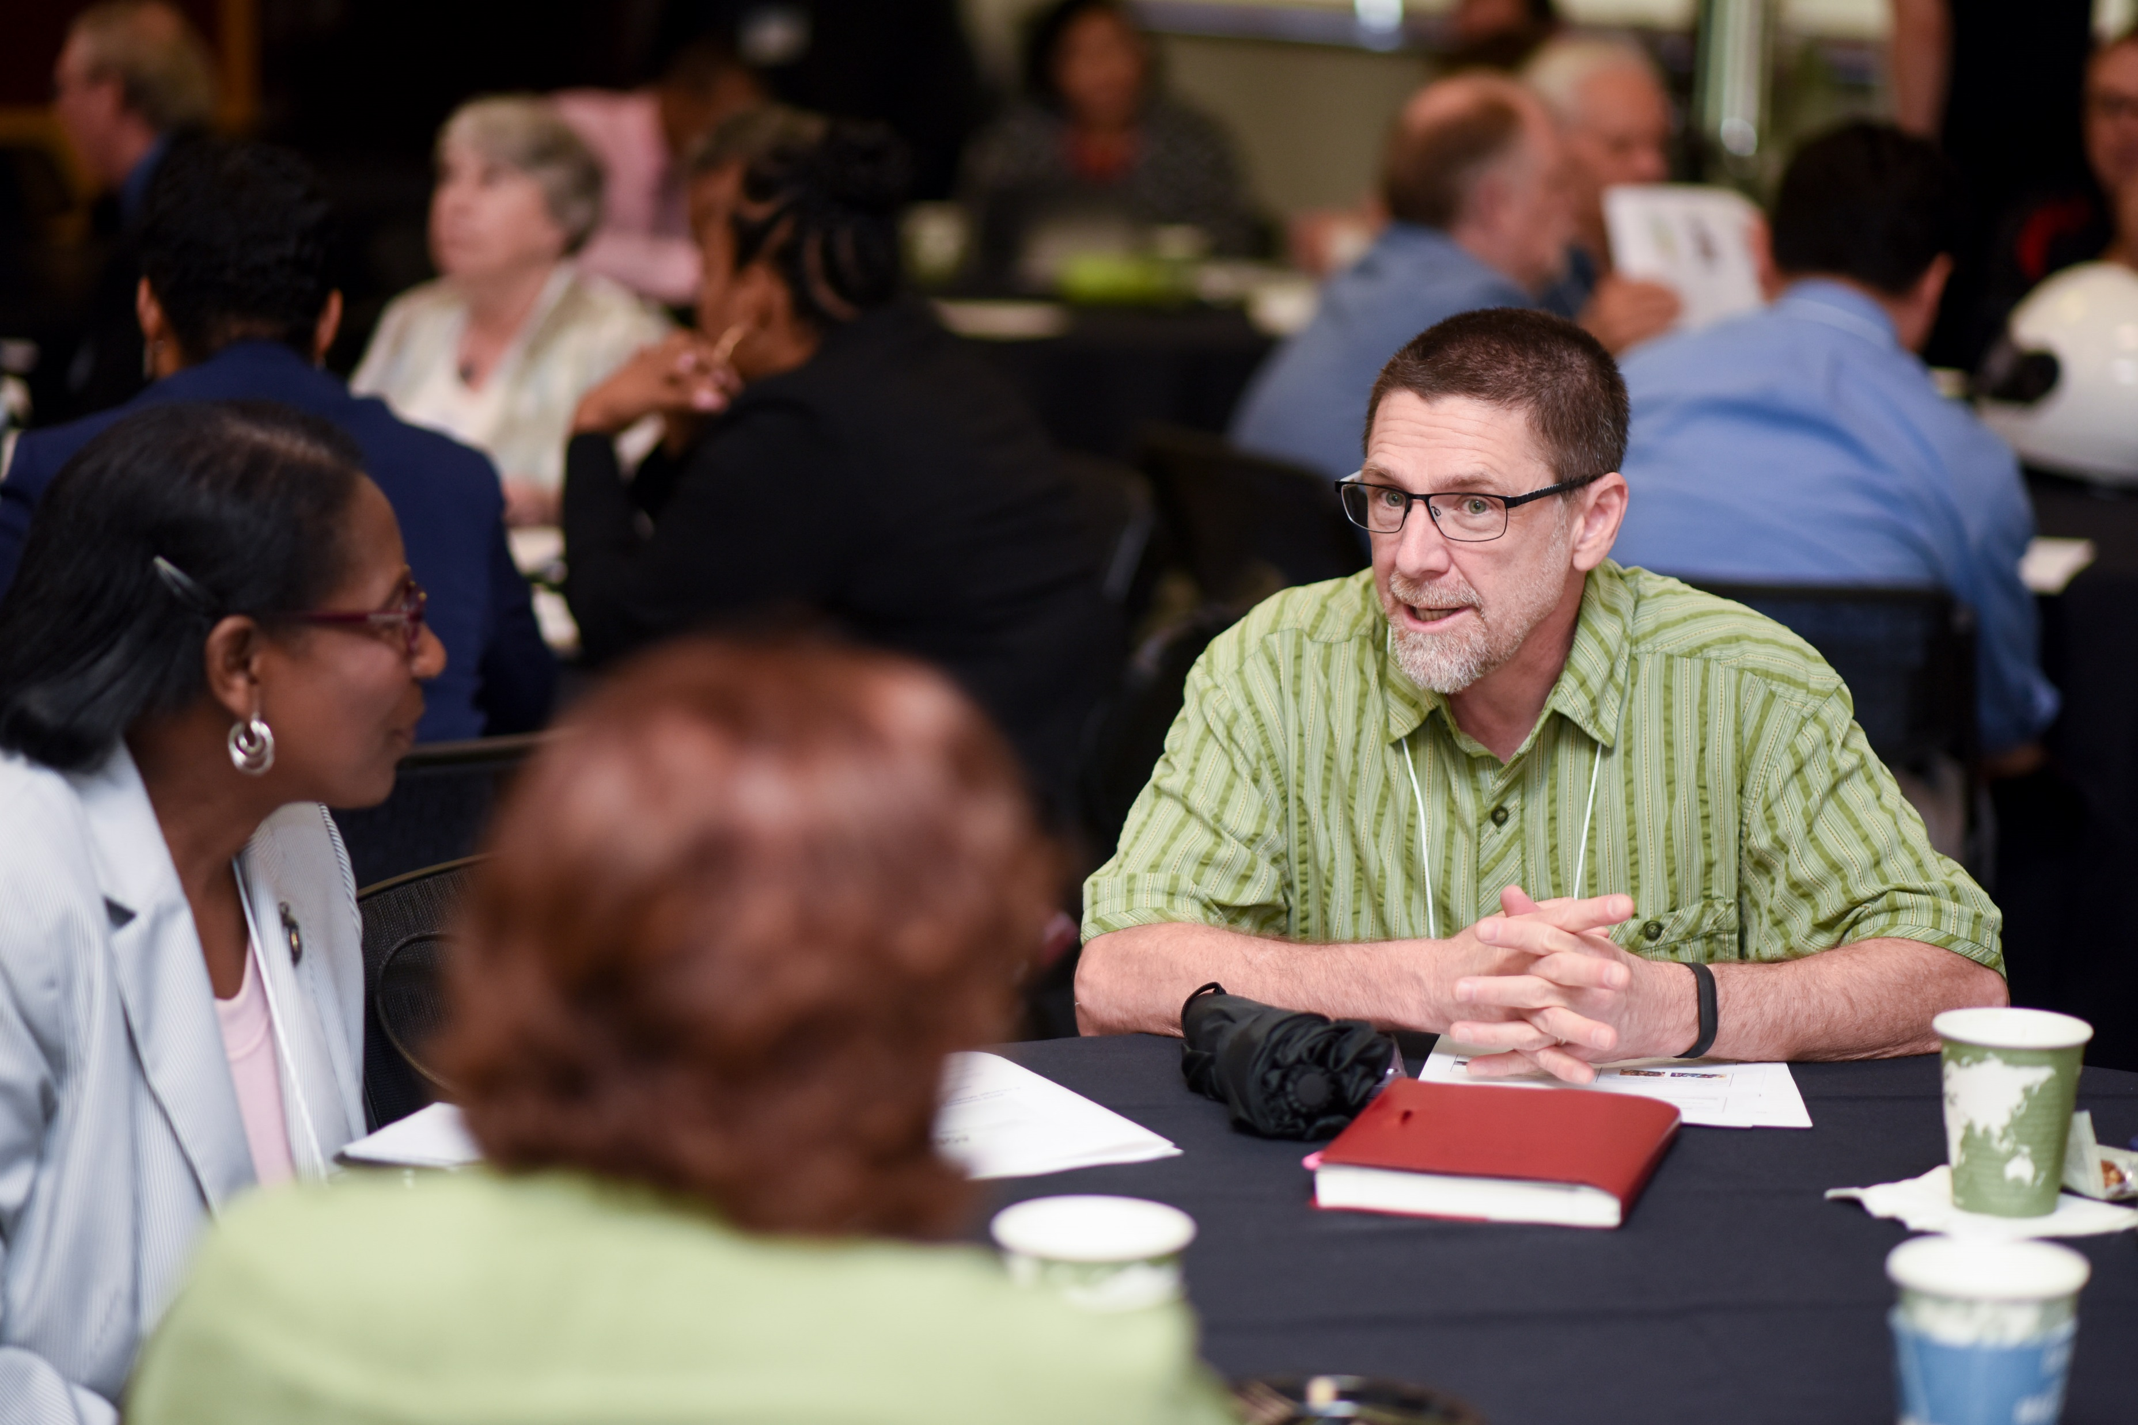
Contributions/Expectations of Participating Departments/Colleges
Identify aspects of program that inhibit URM students
Examine administrative structures to see if you can identify a change that could be made
Educate and engage department faculty in this effort
Document all of these activities
Develop a departmental/college plan for promoting the success of URM doctoral students

Slide 15
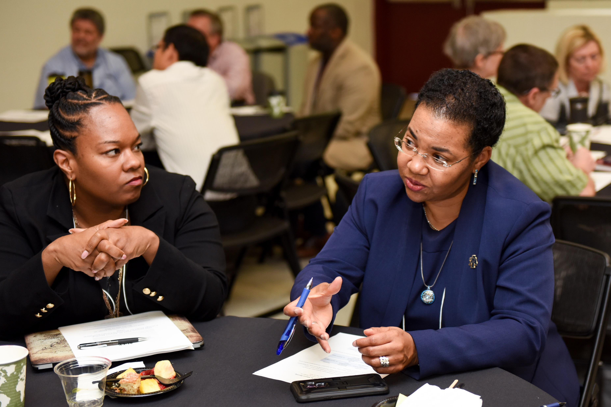
Sensemaking Initiatives
Initiatives to Educate and engage faculty colleagues - Examples
Training for faculty on culturally responsive mentoring
Workshop on experiences of URM doctoral students
External facilitator to lead discussion on diversity in the discipline
Brown bag discussion series on diversity in your discipline
Retreat for students and advisors

Slide 16
Departmental Doctoral Diversity Plans
Possible elements of plans for promoting success of URM doctoral students
Handbook, orientation for faculty mentors and students
Incorporate diversity/inclusion in FAR, SFR, RPT criteria
Flexible qualifying exams
Flexible course requirements tailored to student’s background and interests
Financial support and time for students to take bridge courses if needed
Example plans: https://agep-nc.org/index.php/agep-nc-alliance/department-plans-2/

Slide 17
AGEP-NC Social Science Research
Overarching question
In what ways can mentor training adequately prepare mentors to engage in culturally responsive dissertation mentoring?
Embedded case study design
Interviews, surveys, focus groups of graduate students, faculty advisors, and AGEP-NC Fellows
Results feed back into materials and training for AGEP-NC Fellows

Slide 18
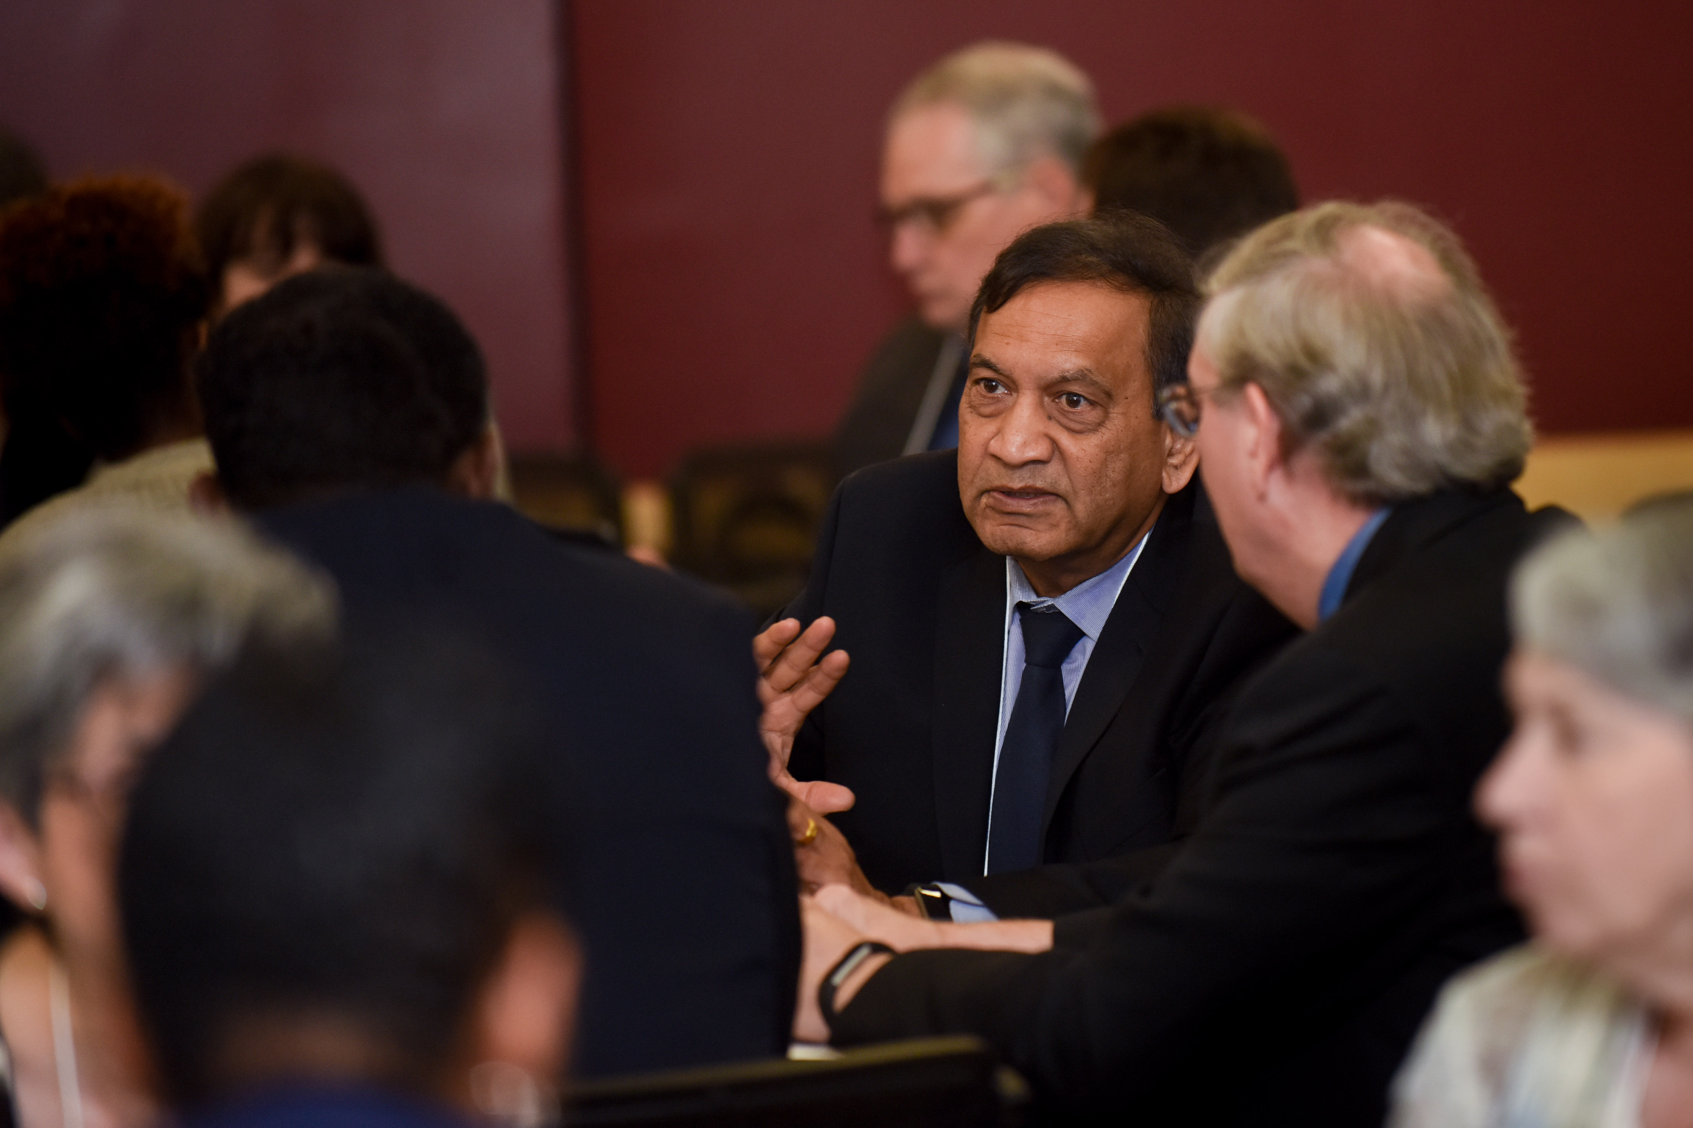
This project will test
How much change can Faculty Fellows catalyze within their departments/colleges?
What modifications are needed to adapt this model to different institutional types?
NC A&T
NC State
UNC-Charlotte

Slide 19
AGEP-NC Outcome Measures
Changes in faculty perspectives regarding diversity in their graduate program
Use of best practices in mentoring URM graduate students
Changes in policies and procedures to enhance diversity support
Climate for graduate students and faculty
URM doctoral students’ completion and entry into faculty positions and postdocs
Description of approaches that promoted or hindered model implementation in specific disciplines or institutions
Adoption of model by other campuses

Slide 20
This Semester
Provide baseline data
Presentation to department faculty and grad students about AGEP-NC
Department self study
CIMER training on culturally responsive mentoring for fellows
Sept 2021:
Climate survey – Fellows
Oct/Nov 2021:
Climate survey – faculty and doctoral students in your department/college

Slide 21
Winter/Spring 2021/2022
January 14, 2022: AGEP-NC Alliance Winter Meeting
Throughout winter and spring: Proposals for sensemaking initiatives
Spring: Implement sensemaking activities

Slide 22
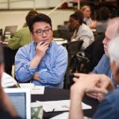
Your Ideas
What will work best in your department/college?
What type of assistance from the AGEP-NC leadership team will be most helpful?

