Slide 1
Department of Marine, Earth, & Atmospheric Sciences (MEAS): AGEP Plan
Walt Robinson, NC State
AGEP-NC 2022 Summer Alliance Meeting
June 29, 2022

Slide 2
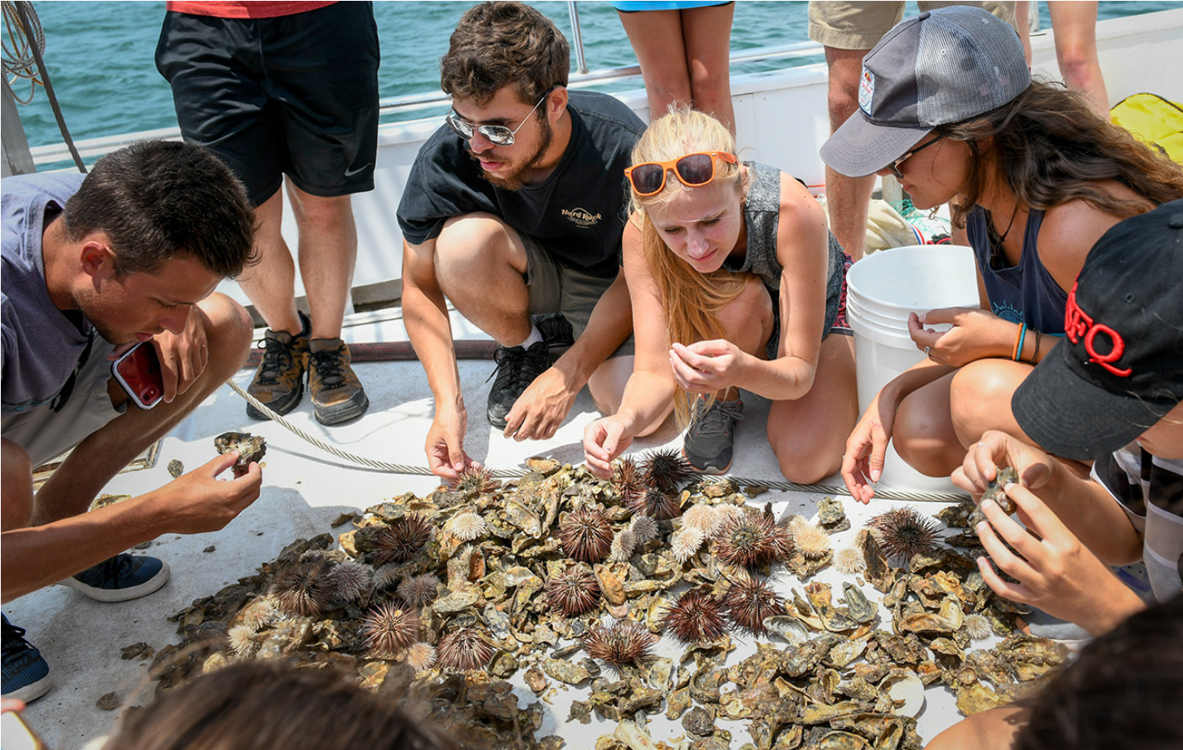
MEAS overview
“Whole Earth” geosciences department
39 faculty: 7 hired since January 2021
poor diversity: 0 Black faculty, 1 Latinx
92 graduate students
~½ in PhD program (many MS students => PhDs)
most on RA/TA support (~15 in professional MS program)
limited diversity: 4 Black students, 1 or 2 Latinx

Slide 3
Geosciences context
Nature Geosciences, April 2018
Historically least diverse of STEM disciplines
Gave rise to URGE (Unlearning Racism in the Geosciences) initiative: national program with hundreds of “pods” & thousands of participants
MEAS had an active URGE pod (22 people)

Slide 4
DEI efforts in MEAS overall
Summer 2019: new department head (Lewis Owen) - strongly committed to DEI
Spring 2020: established departmental diversity and community climate committees
Spring-fall 2021: 4 faculty hires: 3 women, 1 Latinx man
AY 2021-22: search for faculty cluster
emphasized DEI & science supporting historically underserved communities
3 hires (arrive fall & winter): 2 women, 1 non-binary person (all 1st-gen college grads)

Slide 5
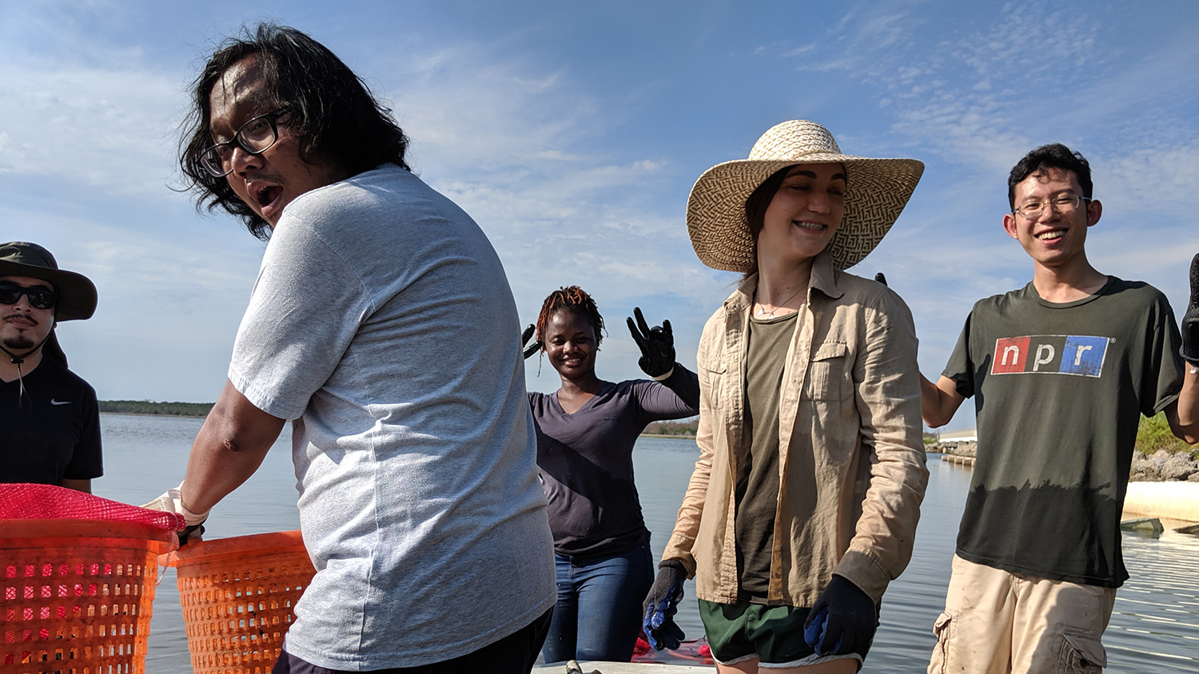
MEAS efforts pertaining to grad students
Spring 2021: dropped GRE requirement for admissions
AY 2020-21: updated graduate handbook (with students)
Fall 2021: clarified information on grad admissions web page (with students)
Fall 2021: developed grad recruitment video

Slide 6
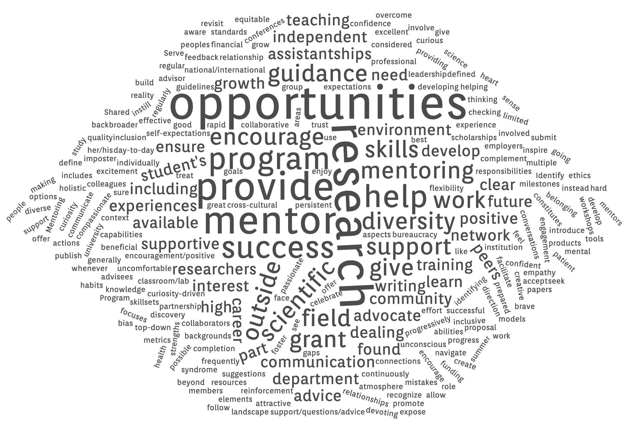
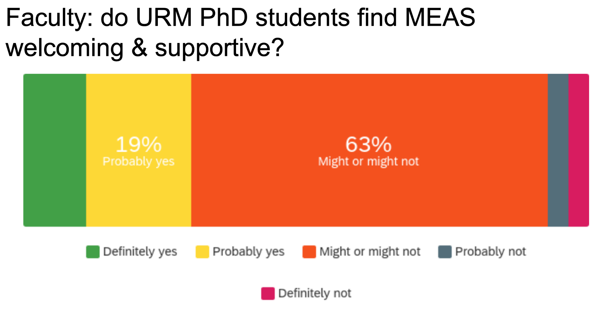
MEAS sense making
Spring 2021: discussions of results of AGEP surveys of faculty and graduate students
Fall 2021: holistic grad admissions workshop (offered by ETS) - expect more discussion from recent Eos article
Fall 2021: faculty workshop - Individual Development Plans for graduate students (Dr. Yvette Huet)
URGE pod; seminars by Rupert Nacoste & Gary Weissman

Slide 7
MEAS plan
Formal mentor training (e.g. CIMER)
New faculty spinning up research groups => fertile ground
Include senior grad students and postdocs
Help with mentoring now (strong faculty interest in this!)
Prepare for faculty roles
Wider adoption of IDPs
New faculty not set in ways
Collaboratively develop model(s) best for our discipline(s)
Pre-career learning for PhD students
Collaboration with MEAS Graduate Student Assoc.
How to compete for faculty positions?
Develop and review application materials
“Writers’ workshop” format

Slide 8
Off script (sorry!)
Raleigh rents rising 20% annually
Stipends not keeping up (they can’t)
Some students get family help to cover the gap
Many cannot - due to historically determined disparities in wealth, many URM graduate students lack family resources to draw upon
Inadequate levels of support (for today’s living costs) threaten the diversity of our graduate programs
Mentoring, however excellent, cannot mitigate this
$ response is needed
NC State charges FT graduate students $1,300/term in fees (similar at UNCC & A&T)
Fee opt-outs, need based fee relief, a fee “holiday”?
Ignoring this problem won’t make it go away

Slide 9
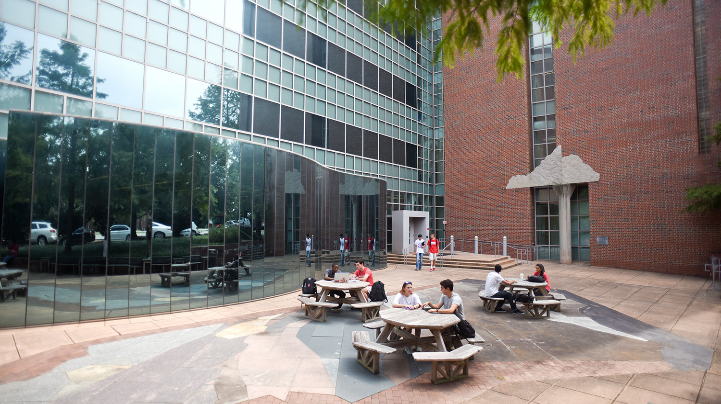
Thank you for listening!
(Questions welcome)

